Slide 1
Microservices and DevOps
DevOps and Container Technology
Horizontal Scaling and Session Management
Henrik Bærbak Christensen

Slide 2
Scalability Quality Attribute

Slide 3
Why?
Scaling ~ ‘make bigger’ in some sense
The two main Quality Attributes in Architectural sense
Performance
Handle more work, and/or handle it faster (latency)
Two persons dig twice as fast as one person…
Availability
Ability to handle work in case of one service failing
Two persons are less likely to be sick at the same time
(give and take a pandemic ☹)

Slide 4
Scalability [Bass et al., 2012]
Vertical Scalability (Scale up)
Adding more resources to a physical unit
More RAM, more Disk, more CPU
Horizontal Scalability (Scale out)
Adding more resources to logical units
More servers
In cloud computing Elasticity
Add/remove VMs to resource pool
Higher Availability ?
Higher Availability ?

Slide 5
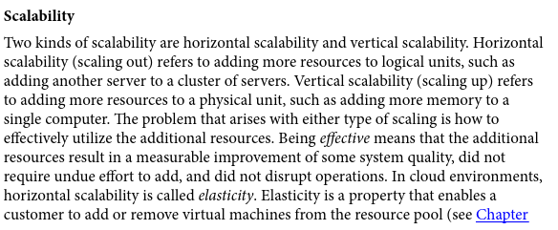
According to Bass et al.

Slide 6
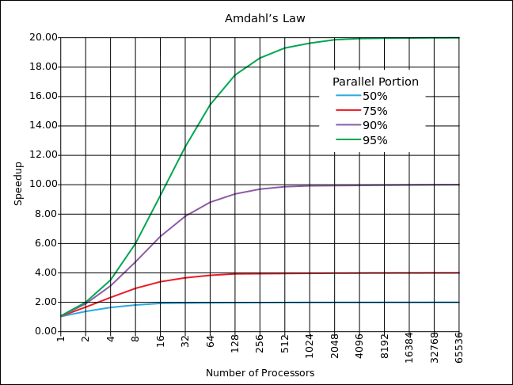
Performance?
Performance
Twice the work? No, now more overhead coordinating!
Much more on that in my ‘Software in Architecture’ fagpakke…
Amdahl’s law
Speedup is limited by the portion that can be run in parallel

Slide 7
Availability Calculations
If a system of n replicated servers in which each server has a probability, p, of failing, then the system has total probability
p^{n} of failing
Ex
p = 5% (0.05)
(72 minutes every 24h)
n = 3
Overall failure rate:
0.05³ = 0.000125 = 0,125 per mille
(10 seconds every 24h)
That is:
1 - p^{n} availability

Slide 8
SkyCave Scalability
Ex: Some 100.000 users on SkyCave
One user ~ one request every two seconds
That is: 50.000 requests per second
Issues:
Try it with ‘socket.cpf’
It is single-threaded server
If ‘quote’ talks to the quote service but it is slow responding (say 10 secs)
Then all 100.000 users will experience a 10 second delay!

Slide 9
SkyCave Scalability
Issues:
The ‘http.cpf’ is a thread-pooled server (Jetty)
So less chance of all waiting for a quote, but…
The server may hit hardware limits in
IO transfer to/from DB
CPU at 100%
One solution: Horizontal Scaling:
Make several instances of ‘daemon’ available for processing
Two can (nearly) do twice as much as one
Coordination effort – shared resources

Slide 10
Load Balancers
One Example of Horizontal Scaling

Slide 11
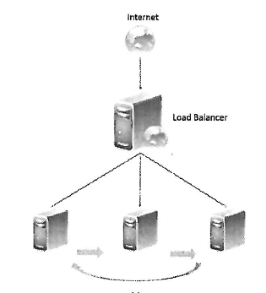
Load Balancer
Load Balancer
Makes the pool of servers under the load balancer appear as a single server with high computing capacity. [Bahga et al., 2014]
Basically a reverse proxy server that distribute requests to a pool of servers based upon some algorithm

Slide 12
Examples
HA Proxy
TCP/HTTP proxy
Used by github, airbnb, instagram, stack overflow, …
Nginx
Round-robin DNS
Multiple ip addresses associated with single domain
Can also give some very weird problems
Hardware load balancers
Docker Swarm’s ingress network
Messaging systems
Can load balance… and a lot more…

Slide 13
Session Management
Statefull versus Stateless

Slide 14
Servers and State
The main requirement on any server that is load balanced is:
It must be stateless
Stateful:
Has cached/stored state about given session with a client in the server itself
Stateless
No stored state about given session in the server itself
Notes:
The ‘in itself’ property is important. Almost all server systems have a lot of state, the point is to store it ‘somewhere else’.

Slide 15
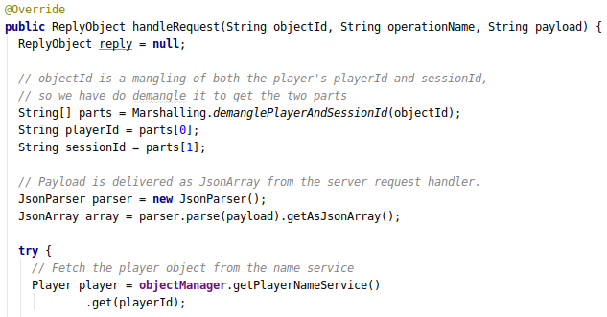
Sessions?
Some domains do not require sessions
Simple web browsing
Simple data storage
Others domains, sessions are vital
Shopping basket while web shopping
Game interaction
SkyCave
Who is exploring?

Slide 16
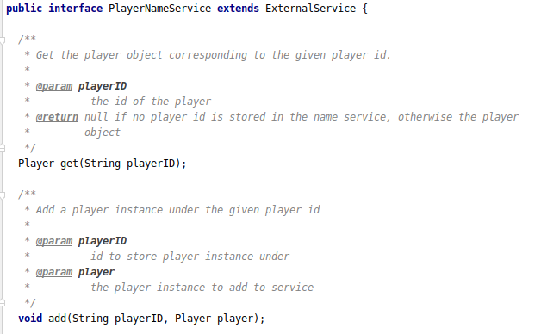
Architectural Design
Ok, so SkyCave has already encapsulated session management?
CaveServant
Encapsulate what varies
Program to an interface
Favor object composition

Slide 17
Session Handling
Bahga et al., 2014, lists the possible practices:
Sticky sessions
All requests from session ‘a’ are routed to the same server
Session database
State of session ‘a’ is stored in a database, which all servers retrieve session state from
Browser cookies (client session)
State of session ‘a’ is stored in client, and sent along to server in each request
URL re-writing

Slide 18
Sticky Sessions
All requests from session ‘a’ are routed to same server
Of course, requires the load balancer to have some logic to make that happen
Example: MQ systems can route messages on ‘topics’
A topic could be ‘skycave.server.1’
Begin forwarded to ‘server1’ because MQ can link ‘*.*.1’ topics to that particular server
Benefits/Liabilities?
Notes:
Pro: Services can be stateful; Con: A crashed service means a client experience a crashed service

Slide 19
Session Database
State of session ‘a’ is stored in a database, which all servers retrieve session state from
Simple load balancing – just ‘round robin’ would do…
Benefits/Liabilities?
Notes:
Benefit: failure tolerance. Liability: Performance cost to contact DB. Often mitigated through caching services.

Slide 20
Client Session
State of session ‘a’ is stored in client, and sent along to server in each request
Browser cookies
Again, load balance is simple
Benefits/Liabilities?
Notes:
Benefit: stateless servers. Liabilities: performance – state object can be big; security – do I trust the client? No I do not…

Slide 21
Discussion
What kind of “session management” is used in SkyCave at the moment?
Sticky session, session database, client sessions
Could we code a ‘client session’ approach?
What would it require?
And… Why can we not use the approach ☺ ?
Notes:
Hint: Think about dual login from different clients.

Slide 22
Discussion
Why do we scale?
A) to get improved availability
Then sticky sessions are problematic
B) to get improved performance
Then it puts a demand on the session database – which is?
Notes:
B) The amount of work our server does takes much longer time than the time to fetch the session data.

Slide 23
Scaling Databases
Statefull services (databases)

Slide 24
Important!
So, … we will return to that in the second course…
Redundancy and Replication are the key techniques.
NoSQL db’s all support it out of the box (to my knowledge)
And the SQL ones have followed suit (to my knowledge ☺)

Slide 25
Summary
More users means more resource demand
Answer: Add resources (or become more efficient)
Horizontal or Vertical
Load Balancing:
Make a server cluster appear like one server
Session Management
Handle that different servers are ‘hit’ by given client

